Slide 1

Cloud Security
Jahanzaib Babar 2019-AG-6055
Muhammad Zain 2019-AG-6079

Slide 2

What is cloud security?
Cloud security is the set of strategies and practices for protecting data and applications that are hosted in the cloud.
Notes:
against unauthorized access, DDOS attacks, malwares, hackers and other similar attacks.

Slide 3
Main cloud security risks | Why?
Data is exposed or leaked
An unauthorized user from outside the organization has access to internal data
An internal, authorized user has too much access to internal data
A malicious attack, such as a DDoS attack or a malware infection, destroys cloud infrastructure

Slide 4

Goal
The goal of a cloud security strategy is to protect data and staying operational in the face of an attack.

Slide 5
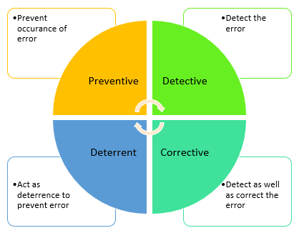
Cloud Computing Security Controls
Consists of the all measures, practices and guidelines that must be implemented to protect a cloud computing environment.
Preventive Controls
Detective Controls
Deterrent Controls
Corrective Controls

Slide 6
Cloud Computing Security Controls (Cont.)
Preventive Controls : Preventive controls prevent a malicious action from occurring.
make the system resilient to attacks by eliminating vulnerabilities in it.
E.g. Data Encryption, Firewalls, etc.
2. Deterrent Controls : Don’t protect the cloud architecture, purpose of a deterrent control is to give a warning signal to stop a threat event.
CCTV cameras, Alarm, Lights
E.g. A log aggregation system
Notes:
A locked door to a room is a preventive control. Intruders cannot go through the door. On the other hand, just a warning sign that says "No Entry" is a deterrent control. Intruders can ignore the warning and enter the room.

Slide 7
Cloud Computing Security Controls (Cont.)
3. Detective Controls : It detect and reacts to security threats and control.
E.g. Intrusion detection software and network security monitoring tools.
Corrective Controls : Corrective controls are designed to minimize the impact of the attack.
E.g. Disaster recovery planning, Incident response planning, Backup procedures

Slide 8
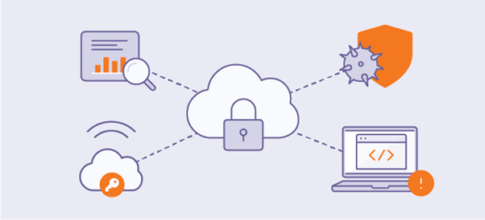
Key Technologies for Cloud Security

Slide 9
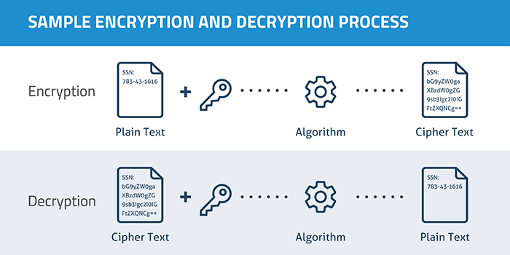
1. Encryption:
Encryption is a way of converting data into non-readable format (i.e. cipher text) that only authorized parties can understand.

Slide 10
Encryption (Cont.)
If an attacker hacks into a company's cloud.
Data can be encrypted both at rest or in motion.
If the cloud in a multi-cloud or hybrid cloud, a VPN can encrypt traffic between them.
If clouds are connected at the application layer, SSL/TLS encryption should be used. SSL/TLS should also encrypt traffic between a user and a cloud.

Slide 11
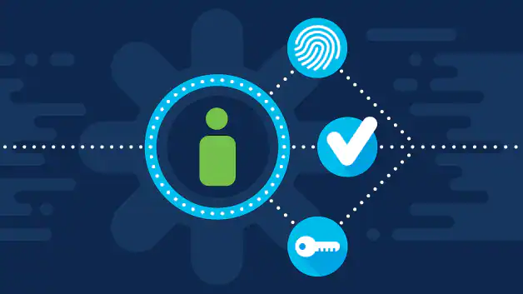
2. Identity and access management (IAM):
Track who a user is and what they are allowed to do.
The right IAM solution will help to stop several kinds of attacks, including account takeover and insider attack

Slide 12
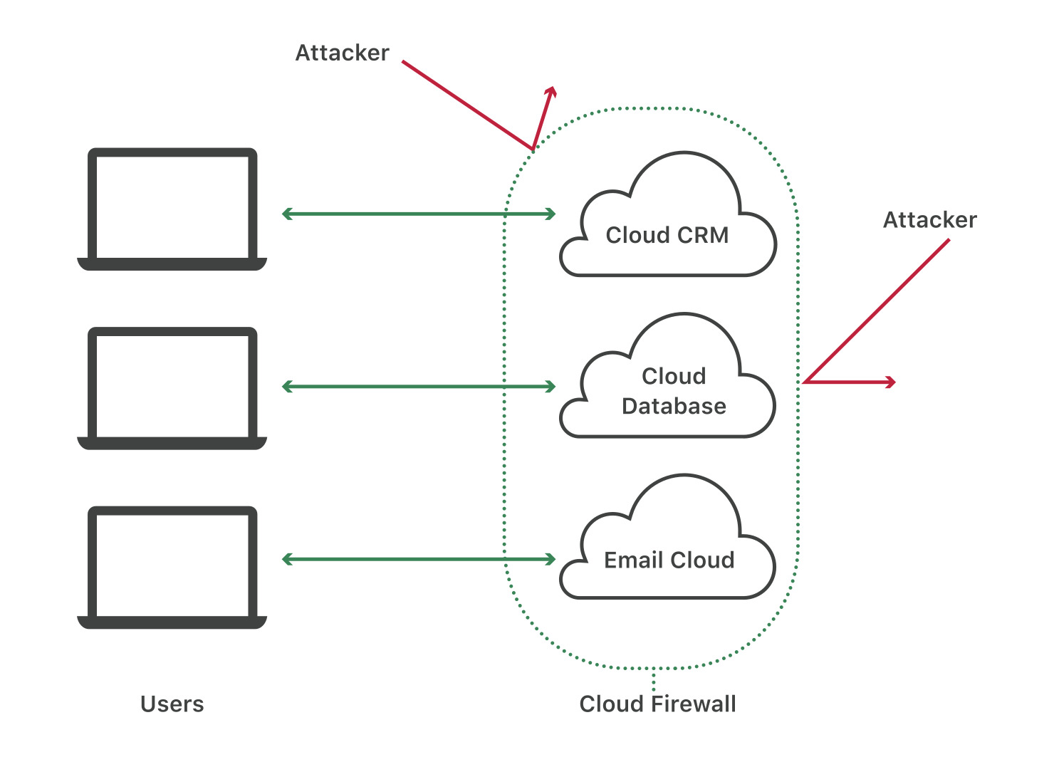
3. Firewall
A cloud firewall provides a layer of protection around cloud assets by blocking malicious web traffic.

Slide 13
Firewall (Cont.)
Cloud firewalls block DDoS attacks, malicious bot activity, and vulnerability exploits.
CloudFlare , AWS , Akamai Site Defender

Slide 14
4. Security Information and Event Management (SIEM)
Automates threat monitoring, detection, and response in cloud-based environments by using artificial intelligence (AI)-driven technologies.
Intrusion Detection System

Slide 15
5. Business continuity and Disaster Recovery
Regardless of the preventative measures…
There should also be a failover plan so that business processes are not interrupted if one cloud service fails.
Data should be backed up in another cloud.
Disaster recovery solutions provide organizations with the tools, services, and protocols necessary to recovery the data & resume normal business operations.

Slide 16
Countermeasures
Implementing the above technologies is not enough
Proper configuration of security settings for cloud servers: it can result in a data breach.
requires team members who are experts.
Keep your Services Up to Date: Ensure cloud systems are not exposed to vulnerabilities due to required updates or patches.
you will have to create your own patch to resolve a specific vulnerability
Use automated tools to continuously verify that all software systems are running the latest version.
Notes:
Example of Capital 1

Slide 17
Countermeasures (Cont.)
User and employee education: A large percentage of data breaches occur because a user was victimized by a phishing attack,
Unknowingly installed malware, used an outdated and vulnerable device, or poor password hygiene are also the reasons.

Slide 18

How should you approach cloud security??
The way to approach cloud security is different for every organization and can be dependent on several variables. However, the National Institute of Standards and Technology (NIST) has made a list of best practices that can be followed to establish a secure and sustainable cloud computing framework.

Slide 19
Research Paper
Author: Kumar
Dated: 2022.
Title: Working Analysis of Multistage Cloud Security Algorithms.

Slide 20
Abstract
The greatest favorable position of cloud is that one can work online in the cloud, whenever the term online comes it automatically concerns about data security. In cloud storage we require security for the data so we will encrypt our data into cipher text before uploading and whenever we want access just decrypt cipher text with security policies. In this paper we are analyzing the symmetric encryption algorithm with asymmetric algorithm like DES, RSA and AES, IDEA, Blowfish etc. to provide security to cloud data from attackers

Slide 21
Reference
https://www.cloudflare.com/learning/cloud/what-is-cloud-security/
https://www.ibm.com/topics/cloud-security
https://www.avast.com/c-b-what-is-cloud-security
https://subscription.packtpub.com/book/cloud-and-networking/9781838989583/2/ch02lvl1sec06/types-of-controls
https://www.techopedia.com/definition/29367/cloud-security-control
https://www.geeksforgeeks.org/cloud-computing-security/
https://en.wikipedia.org/wiki/Cloud_computing_security
And some other sites also used

Slide 22

Any Question!

